Slide 1
The Principles You Need to Know (and those you should forget)
David Sackstein

Slide 2
Overview
In this module we will review the most essential principles of software design.
Building on these, we will review the three pillars of OOD. Encapsulation, inheritance and polymorphism. Do we actually need them and why?
We will engage in an open discussion and the conclusions will be demonstrated with code examples. The examples will demonstrate common pitfalls, the techniques you can use to identify the problems, and how to fix them using simple C++.

Slide 3
Agenda
Causes of complexity
The principles you need to know
The Single Responsibility Principle
Encapsulation
Prefer Composition over Inheritance
The Open Closed Principle
System Organization and Refactoring
What you should forget
Inheritance

Slide 4
Causes of Complexity
Too many dependencies between components (coupling)
Components that have too many responsibilities
Components that are large
Components with unclear usage contracts
Components that expose their implementations
Quick and dirty changes that introduce these problems over time

Slide 5
Addressing complexity
Break large solutions into smaller components
Each component should have:
one responsibility
a clear and simple interface
tests that use the interface
Each component should use
only a small number of other components
the public interface of other components

Slide 6
Benefits of reduced complexity
Testability
Components with a single responsibility and a clear contract can easily be held responsible.
Extensibility
Abstractions are extension points. New implementations do not affect other components.
Readability
Smaller, isolated functionality is easier to reason about

Slide 7
Benefits of reduced complexity
Maintainability
Easier to read is easier to understand.
Easier to test is safer to change without regression.
Reusability
Components with fewer dependencies carry less “baggage”.
Components with a clear contract are easier to “sell”.

Slide 8
The Principles You Need to Know
The Single Responsibility Principle
Encapsulation
Prefer Composition over Inheritance
The Open Closed Principle
Immutability is your friend
System Organization and Maintenance

Slide 9
The Single Responsibility Principle
Classes and methods should have only one responsibility.
Horizontally:
Implement one feature
Vertically:
One level of abstraction
Try to state the responsibility without using the word “and”.

Slide 10
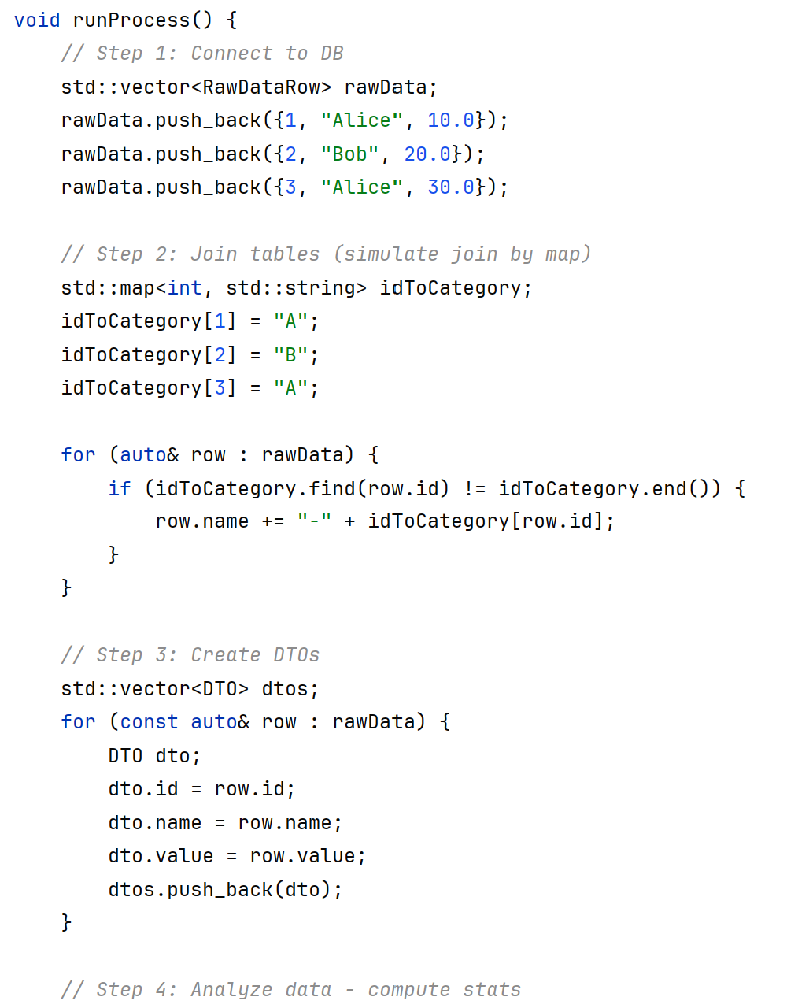
Too long
Too much detail

Slide 11
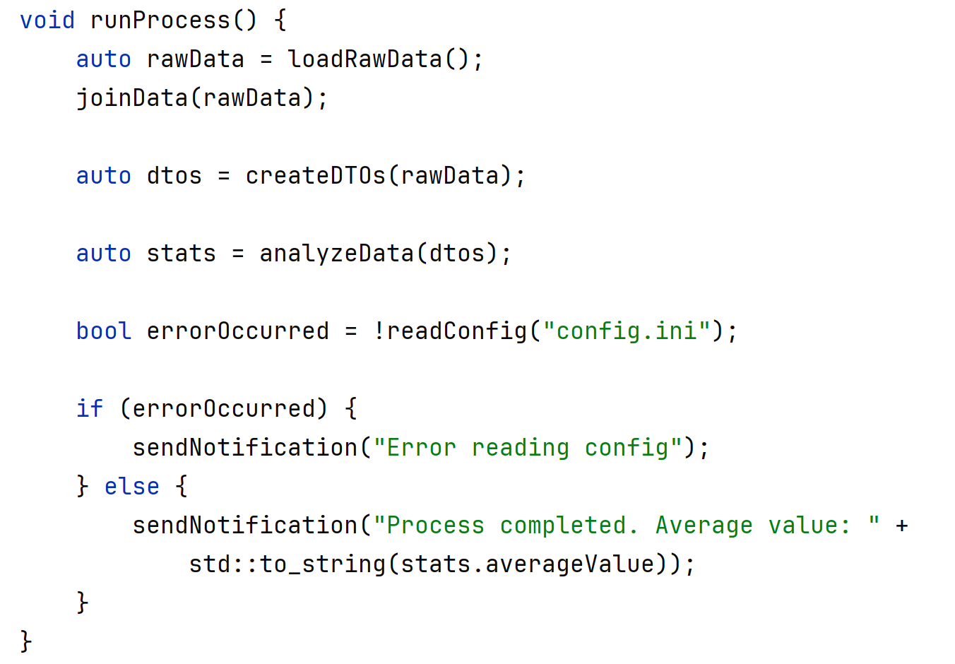
After extraction of methods, the method is clearer
But there are mixed levels of abstraction

Slide 12
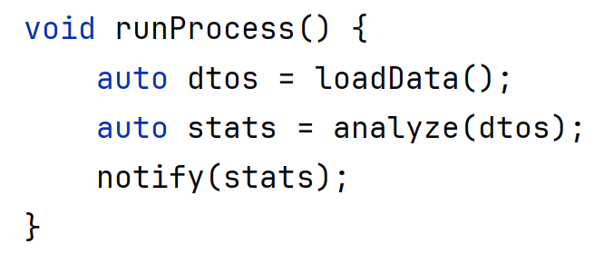
After further extraction runProcess does only one thing.
It breaks down the process into 3 parts at the same level of abstraction

Slide 13
The Single Responsibility Principle
Each file, class, function, library should have one responsibility.
One file should contain only one class
Responsibilities can often be measured in size:
File < 200 lines
Function < 15 lines
Class header < 50 lines
Class source < 200 lines

Slide 14
The Single Responsibility Principle
A good indication of SRP violations is a lack of cohesiveness.
A cohesive class is one in which most fields are referenced by most methods.
An island of associated fields and methods should really be a class by itself.
Extract islands as classes.

Slide 15
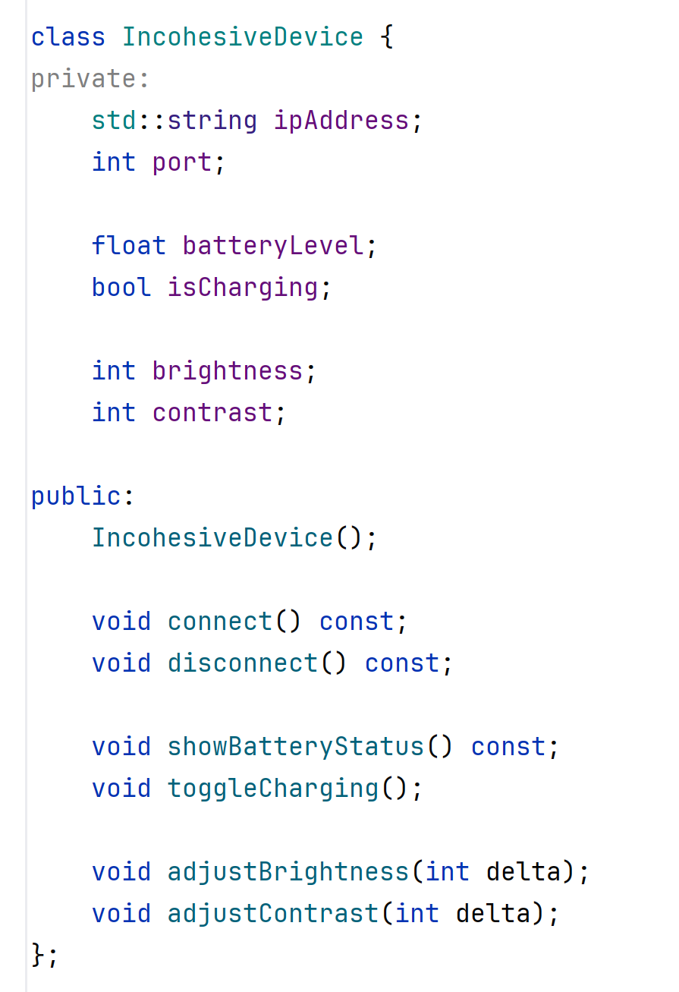
Connectivity
Battery
Display
IncohesiveDevice has three responsibilities and three islands of fields and methods

Slide 16
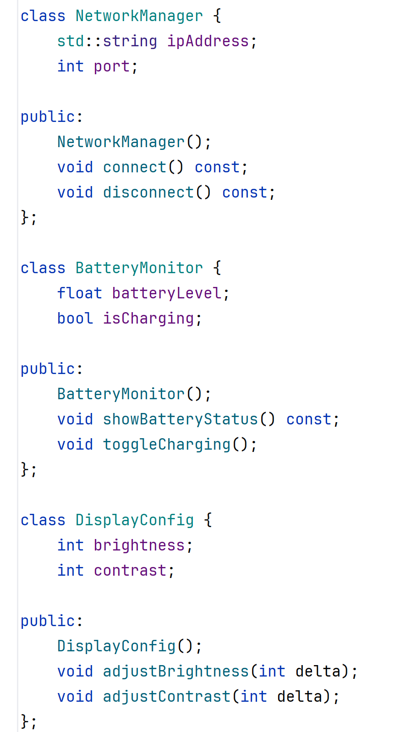
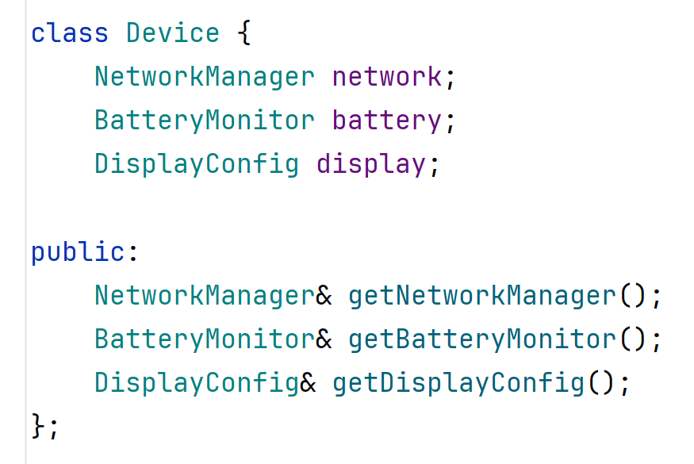
Extract classes
Device is now a manager of objects, each with a single responsibility

Slide 17
Encapsulation
The Three Pillars of Object-Oriented Design
Encapsulation
Polymorphism
Inheritance
Which do we need and which should we avoid?
Encapsulation is the most important
Polymorphism helps achieve encapsulation
Inheritance (code reuse) undermines encapsulation

Slide 18
Two types of inheritance
Polymorphism: Inheritance of contract
A commitment by the implementor and
A capability a consumer can depend on
Code Reuse: Inheritance of implementation
Derived classes call methods of their base class
Template method: The base class also calls virtual methods of the derived class.

Slide 19
Polymorphism: Benefits
Encapsulation: Users of the interface cannot see the implementation
Programming by contract: Users of the interface can clearly see the contract
Benefits of encapsulation:
Testability: Replacement of implementations using mocks.
Extensibility: Upgrading implementations without rebuilding the caller.

Slide 20
Polymorphism: Pitfalls?
Encapsulation (!):
Users of the interface cannot see the implementation
This may make it difficult to fully understand the code, but not really
It’s a trade-off because:
Caller code should actually be easier to understand if the implementations are hidden
But there is such a thing as over abstraction

Slide 21
Inheritance for Code Reuse: Benefits
Avoids code duplication by
Moving common code into the base class
Moves varying code into derived classes
It’s so easy! You can call the implementation without specifying the name of an object

Slide 22
Inheritance for Code Reuse: Pitfalls!
It introduces coupling between the derived class and the base class:
Includes of the derived’s header must also include the header of the base.
The size of the derived class depends on the size of the base. So, if the base changes you need to recompile. (No runtime compatibility)
May introduce cyclic dependencies, because the base class can call the derived class and vice versa
Effectively the base and the derived classes are one big class split across multiple files
This is a violation of the SRP

Slide 23
Inheritance for Code Reuse: Pitfalls!
It breaks encapsulation
The derived class has access to all public members of the implementation class.
It’s like marking your implementation fields and methods public.
All members of all base classes are in the same namespace and can be confused without warning (the diamond problem)
It limits testability of the derived class
The implementation in the base class cannot be replaced by a mock in a test
Coupled classes can only be tested together
It limits reusability of the derived class
The derived class can only be reused if the implementation provided in the base class is desired

Slide 24
And it gets worse
Often, inheritance is used to achieve both goals (polymorphism and code reuse)
A glorious violation of the Single Responsibility Principle
This complicates the class giving it multiple responsibilities.
The relationship between base and derived are not clear making it difficult to maintain
Large inheritance hierarchies are difficult to maintain
When implementations change, inheritance relationships are required to change.

Slide 25
Summary so far
Inheritance of Contract: Good
Inheritance of Implementation: Bad
Exception: Data classes can use inheritance because:
Data class expose all their data as public. No need for encapsulation
There are no methods in data classes, so no cycles
We don’t test data classes

Slide 26
Prefer Composition over Inheritance
For code reuse – use composition
Everywhere you use inheritance today you can use composition:
When derived class uses the base class
The base class becomes a member
When base class uses derived class
The derived class becomes a member

Slide 27
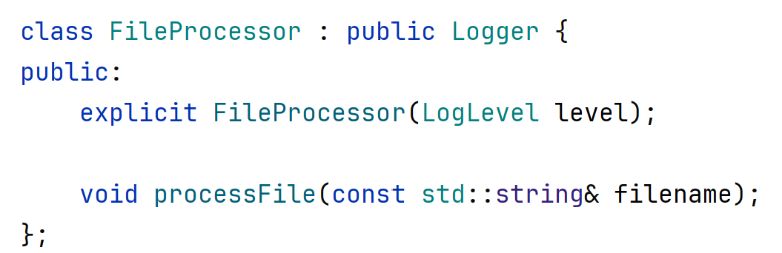
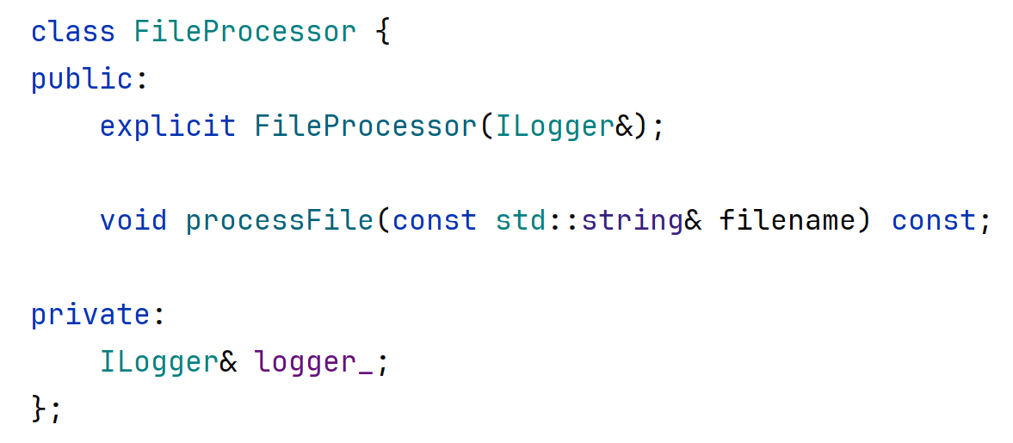
Base class becomes a member

Slide 28
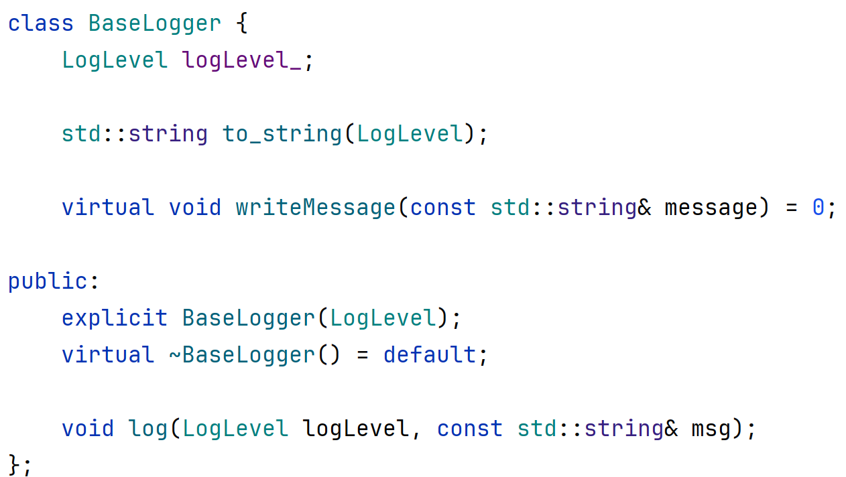
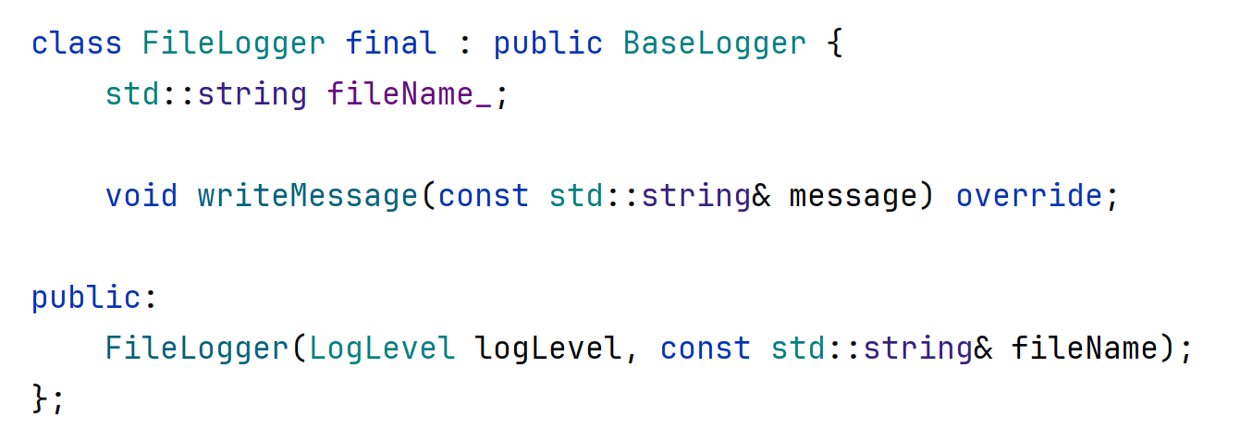
Derived class becomes a member

Slide 29
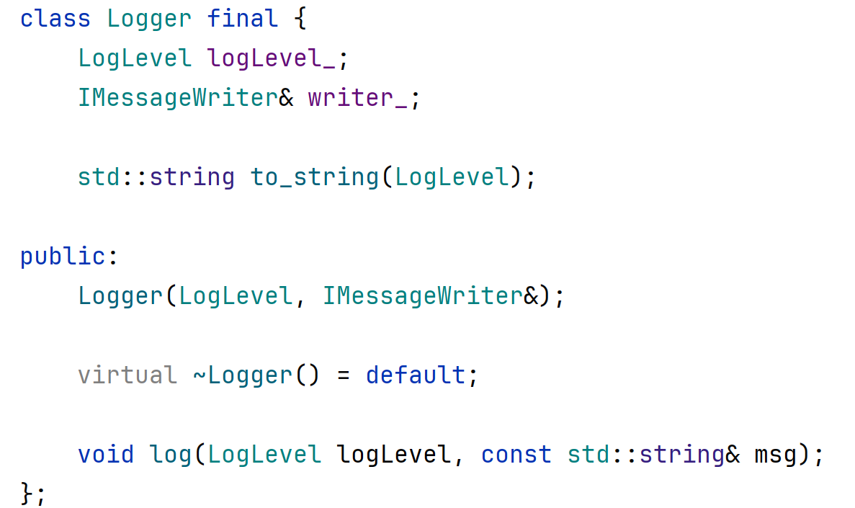
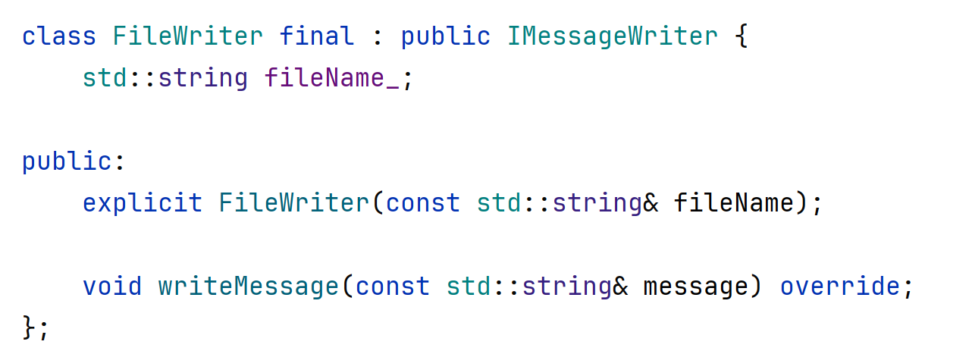
Derived class becomes a member

Slide 30
The Open Closed Principle
A design should be Open for extension and Closed for modification.
That is, adding new functionality should not require changing existing functionality.
Avoid premature generalization:
Do not add features you don’t need
Do not add empty interface methods to generalize
But do use abstractions to simplify extending later.

Slide 31
Immutability is your friend
An immutable class cannot be modified
This means that you only need to see its constructor to know its state.
This reduces complexity and simplifies debugging
Functional programming languages force immutability (the cost is copying).

Slide 32
Immutability in C++
C++ is not strictly a functional programming language.
It is an object-oriented language which typically uses mutation of state.
Use const wherever possible.
Dependencies, for instance should not be modified during the lifetime of an object.

Slide 33
System Organization
Divide large projects into small components.
Each component should have only one responsibility.
Express the responsibility by a simple contract.
Encapsulation: hide implementation details.
Abstraction: allows interchangeability of components

Slide 34
Refactoring
When adding new functionality, favor creating a new class (and file)
When a function or class grows to big, extract methods and classes.
Use (and add) tests to ensure there are no regressions.

Slide 35
Key Takeaways
The SRP | One class per file, should do one thing
The OCP | Avoid premature generalization
Encapsulation | Use visibility and interfaces
System Organization | Classes galore, divide files into folders
Inheritance | Don’t use it for code reuse. Composition!
Refactor, refactor | Get addicted. (You will need tests)
Decoupling | Coming up, with dependency injection!

